Slide 1
Mapping Disease Genes using Recessive Diplotypes and Shared Chromosomal Regions
Steve Schrodi
Center for Precision Medicine Research
Marshfield Clinic Research Institute

Slide 2
Outline
Background
Exome-wide Gene-based Recessive Diplotype Scan
Three Statistical Genetics Vignettes:
Recessive Disease Prevalence Estimation
Generalized Multiplicity Correction
A Fine Mapping Theorem
IBD Mapping in Rheumatoid Arthritis

Slide 3
Background

Slide 4
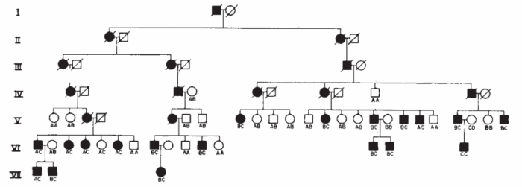
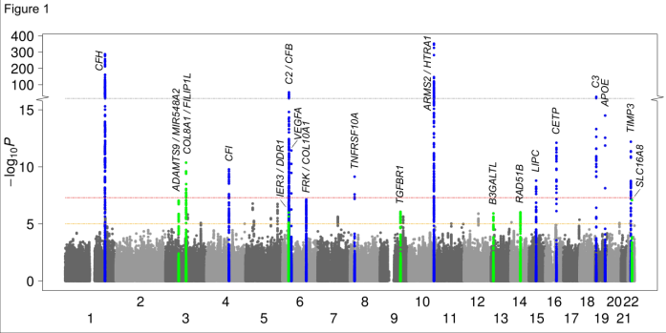
Genetic Architecture of Diseases: Results
Linkage mapping in multiplex families: Rare, highly penetrant alleles identified primarily in uncommon diseases
Linkage in affected sib pairs: Some chromosomal regions identified in both common and rare diseases, but infrequently leading to specific alleles
GWAS: Numerous high freq alleles found of mild effect sizes for common diseases
Association-based NGS: Typically, rare variants found at GWAS-identified genes
Gusella et al. (1983) Nature
Prescott et al. (2006) Mol Psych
Fritsche et al. (2016) Nat Genet

Slide 5
Genetic Architecture of Diseases: Results
While heritability studies estimate fairly high values across complex diseases, the large majority of this heritability remains unaccounted by results from large GWAS
To identify additional disease susceptibility variants, it is imperative that we understand which models of disease genetics are plausible

Slide 6
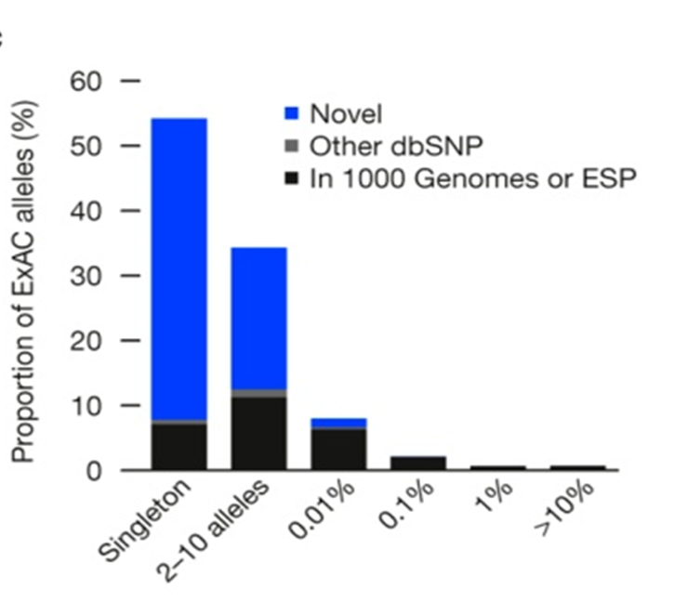
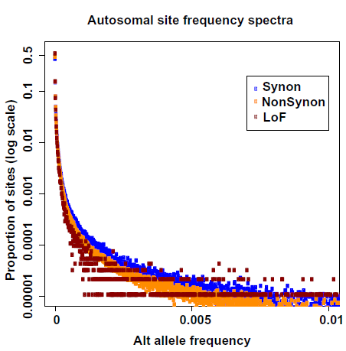
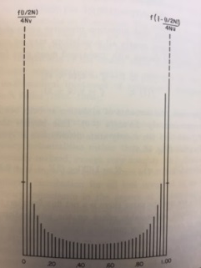
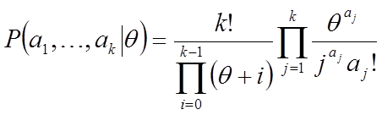
Genetic Architecture of Diseases: Rare Variants
60,706 whole exomes
50,726 whole exomes
Lek et al. (2016) Nature
Dewey et al. (2016) Science
Ewens, 1972
Wright, 1931

Slide 7
Genetic Architecture of Diseases: Consistent Models
High allelic heterogeneity
Massive reservoir of rare variants in humans
Following deep sequencing, we typically discover multiple disease-predisposing alleles at each susceptibility gene
High locus heterogeneity
Use of clinically-defined phenotypes engenders locus heterogeneity
Population histories generate locus heterogeneity
Basic biochemistry and systems biology argues for multiple loci

Slide 8
Exome-wide, Gene-based Recessive Diplotype Scan
Single Site Recessive Effects
Compound heterozygosity
Gene-based Exome Scan

Slide 9
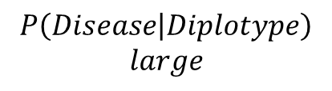
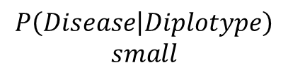
Recessive Diplotype Scan
Power calculations
2-locus model
Gene-based Monte Carlo
using 1000 Genomes
P₁₁
P₁₂
P₂₁
P₂₂
P₁₂ | P₁₂
P₁₁ | P₁₁
P₁₂ | P₂₁
P₁₁ | P₁₂
$$P\left(Disease | Diplotype\right)$$
$$small$$
P₁₂ | P₂₂
$$P\left(Disease | Diplotype\right)$$
$$large$$
P₁₁ | P₂₁
P₂₁ | P₂₁
P₁₁ | P₂₂
P₂₁ | P₂₂
P₂₂ | P₂₂

Slide 10
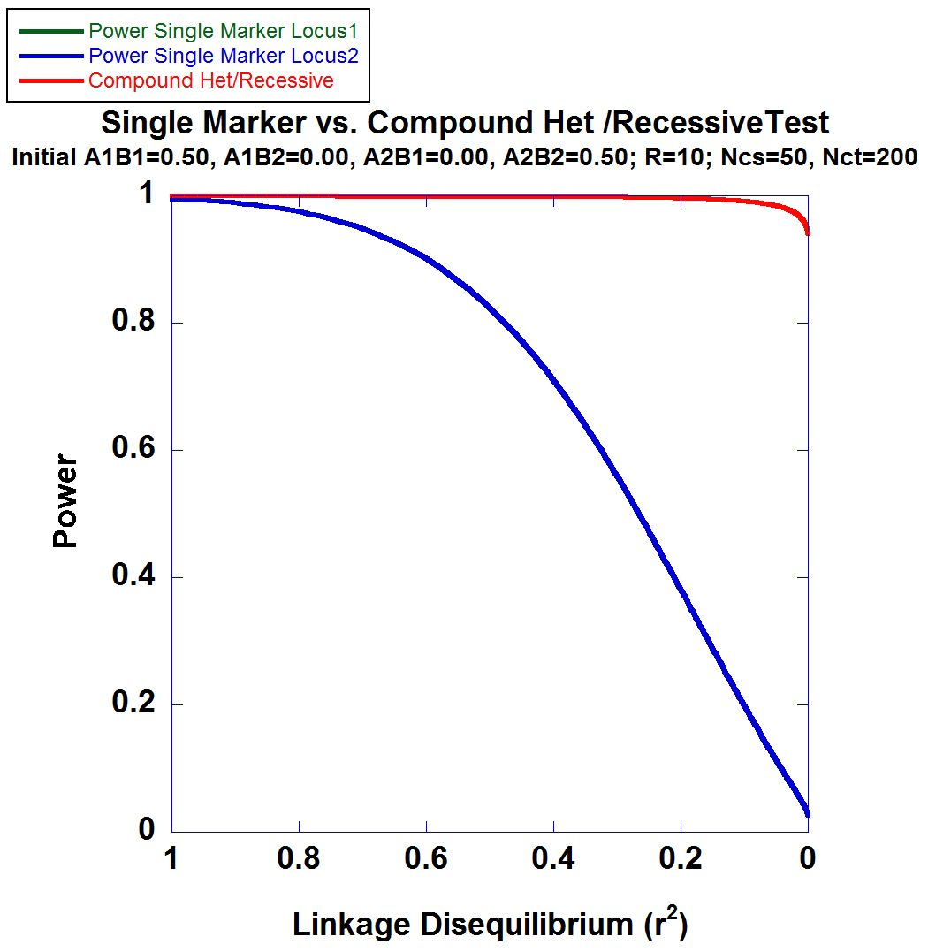
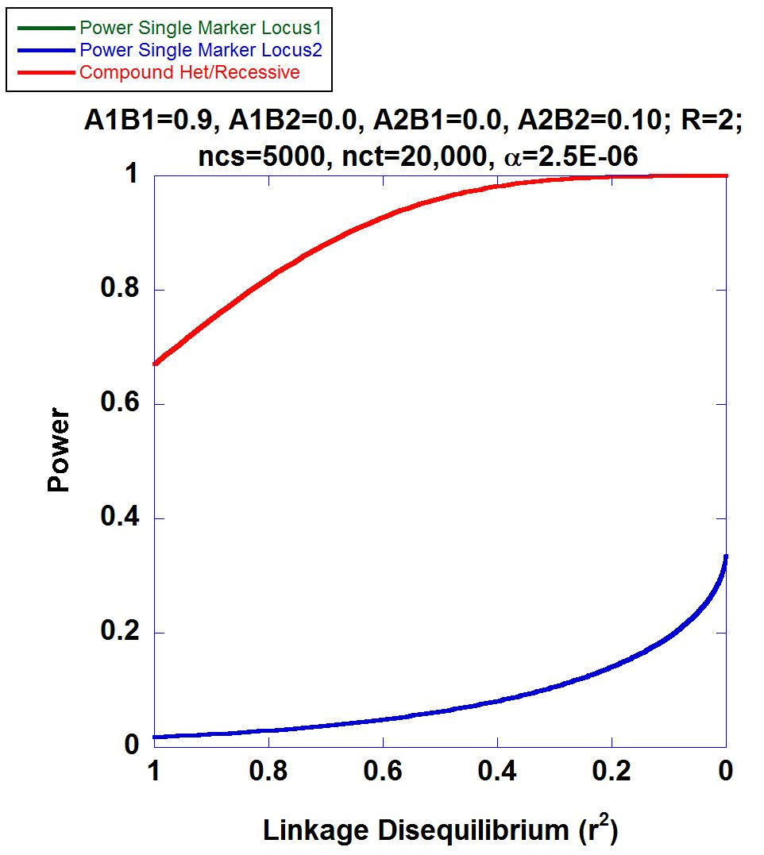
2-locus Power Calculations

Slide 11
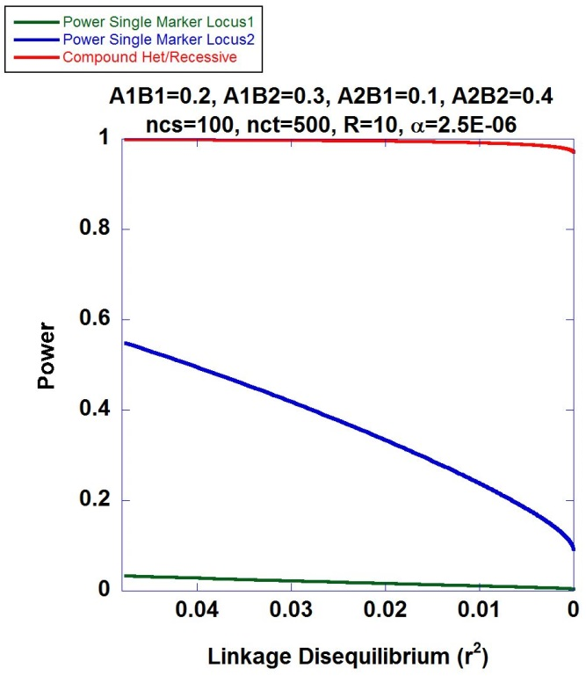
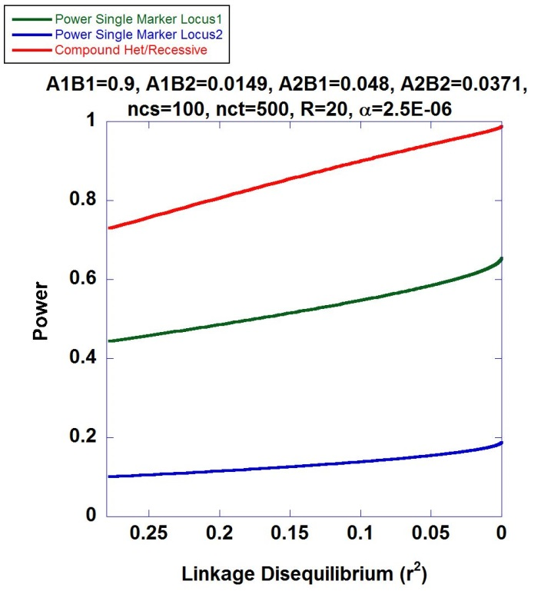
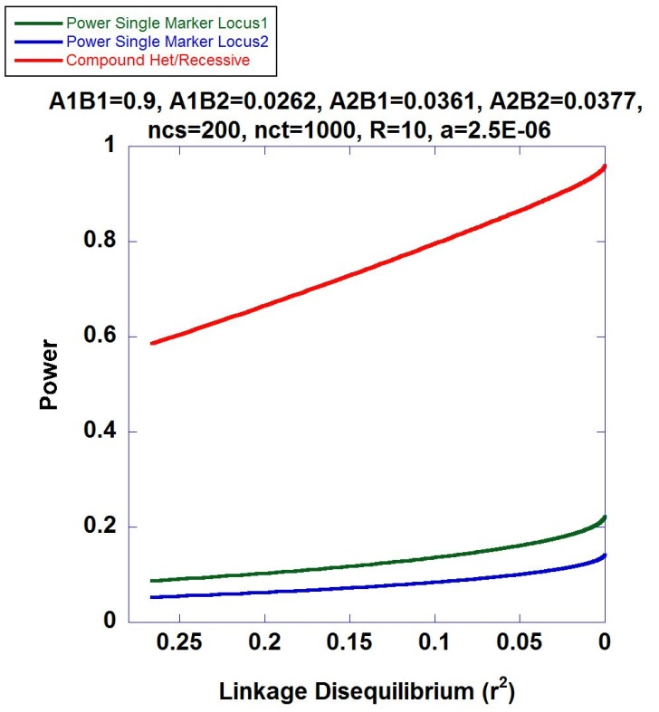
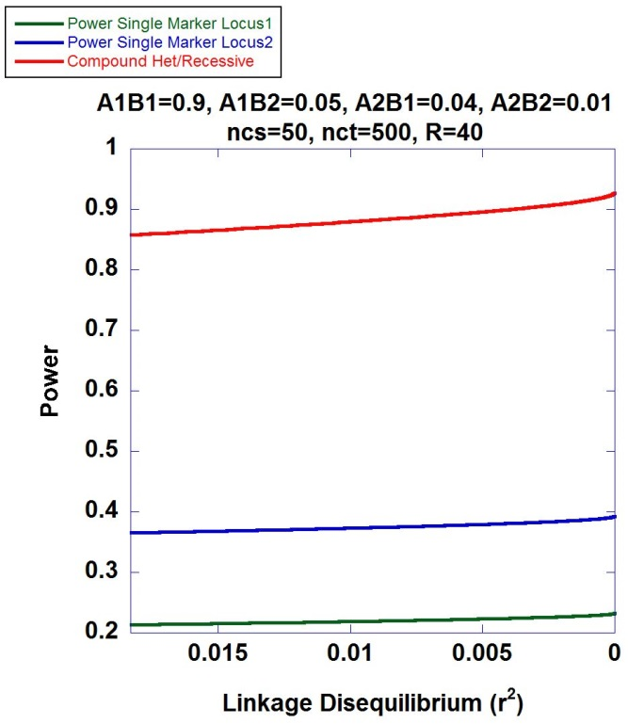
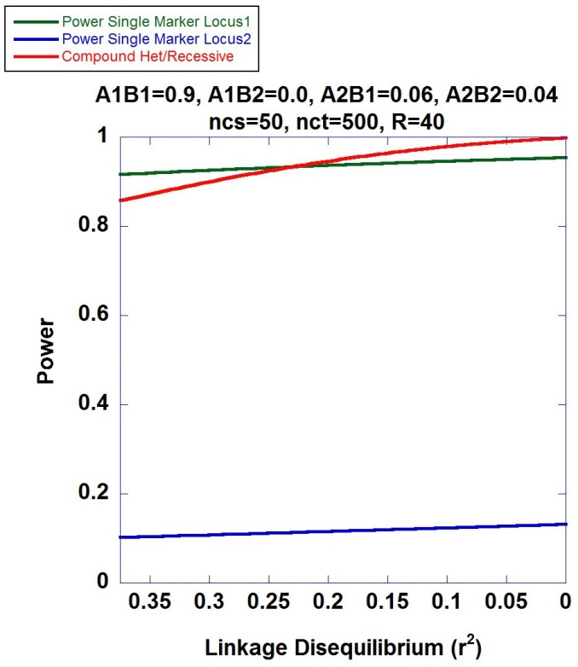
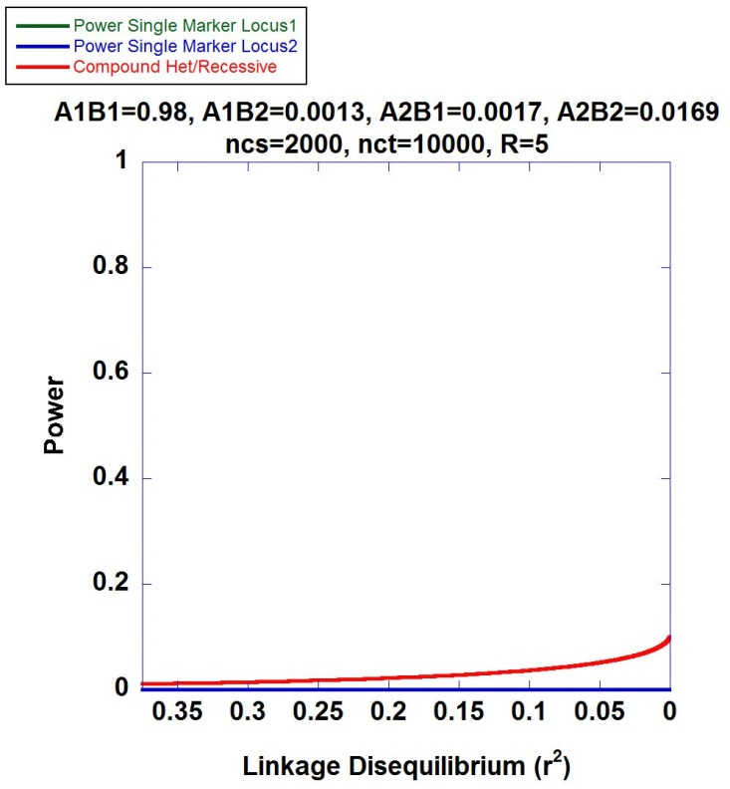

Slide 12
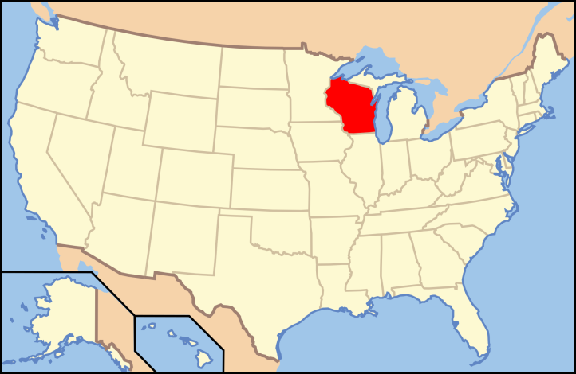

Personalized Medicine Research Project The Central Wisconsin Population
Biobank of 20,000 individuals
Stored plasma, serum, DNA
19,000 exome beadchip
Electronic Medical Records >34 yrs
>80% of the individuals surrounding Marshfield trace their ancestry to Bavarian settlers in the late 1800s.
Low migration
Roughly five meioses since founders

Slide 13
Application: Iron Overload Disorder
Exome beadchip data used on 10,000 subjects
PCA used to exclude genetic background outliers
Phasing using localized haplotype clustering
Putative functional variants: GWAS-significant, nonsynonymous, 3’UTR, 5’UTR, or splice site
Two or more in silico pathogenic annotations
ICD9: two or more instances of (i) iron metabolism disorder, excluding anemia (ii) hereditary hemochromatosis, (iii) unspec hemochromatosis
Transferrin saturation (ratio of serum iron to transferrin iron-binding capacity) > 48%
18 cases identified and 6,896 controls

Slide 14
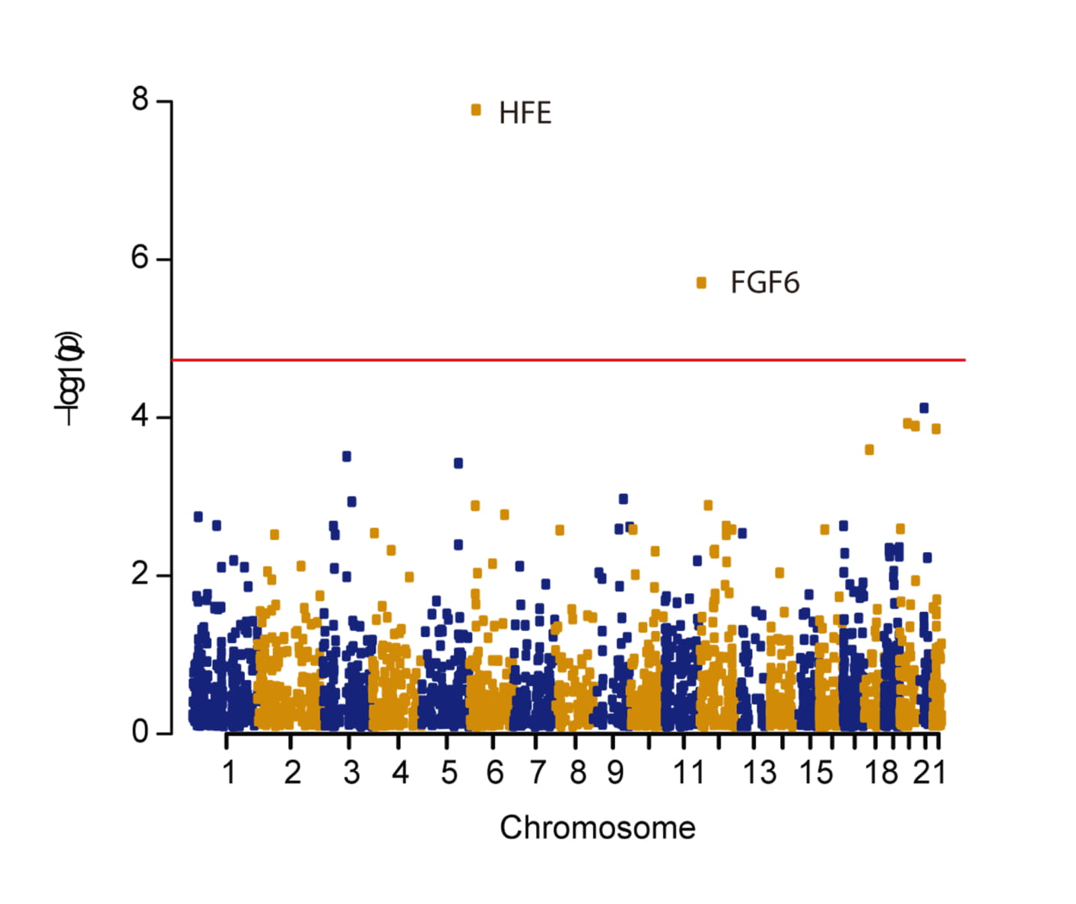
Manhattan Plot

Slide 15
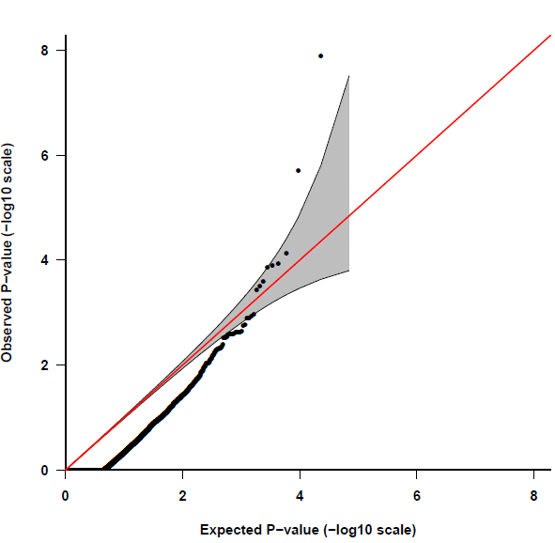
Quantile-Quantile Plot
HFE
FGF6
~ false pos rate 0.08

Slide 16
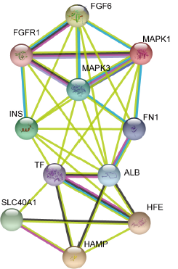
FGF6
Encodes for the fibroblast growth factor 6 protein
Expressed across numerous tissues including skeletal muscle,
blood, liver and pancreas
Protein-protein interactions suggest
involvement of FGF-6 with Fe-metabolism
subnetwork

Slide 17
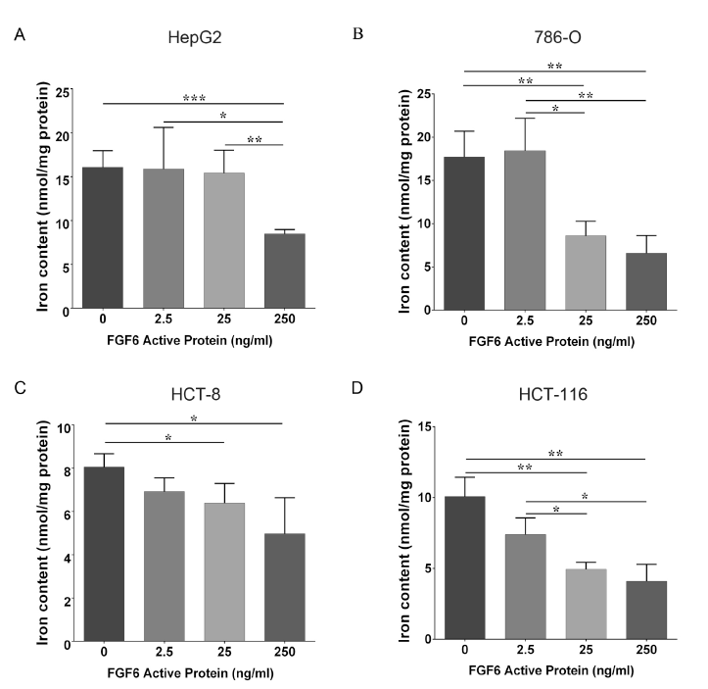
Dose-Dependent FGF-6 Impact on Intracellular Iron
Ferrozine assay after
48h incubation on four
cell lines

Slide 18
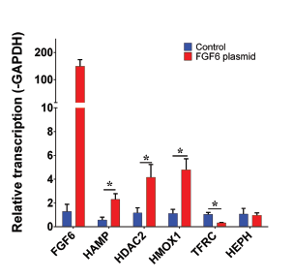
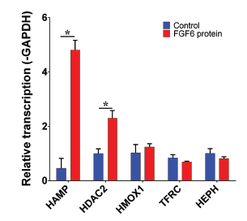
FGF-6 and FGF6 Transcriptional Regulation of Hepcidin (HAMP) in Hepatocytes
HAMP encodes for hepcidin
HDAC2 encodes for histone deacetylase 2
HMOX1 encodes for heme oxygenase 1
TFRC encodes for transferring receptor 1
HEPH encodes for hephaestin

Slide 19
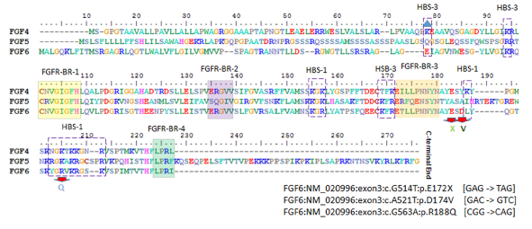
Evaluation of Three FGF6 Nonsynonymous Putative Functional Variants
Within or adjacent to heparin binding site motifs

Slide 20
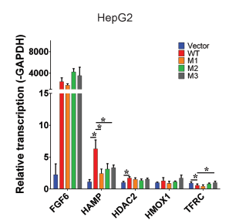
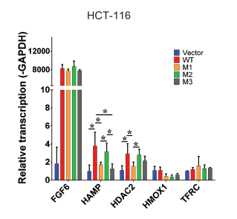
Variants Show Attenuation of Hepcidin Transcription Compared to Wildtype
M1: E172X
M2: D174V
M3: R188Q

Slide 21
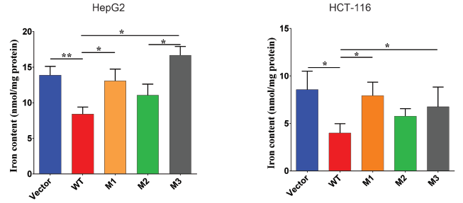
Variants Show Reduced Attenuation of Iron Uptake

Slide 22
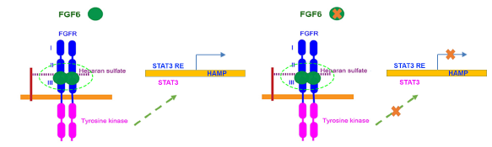
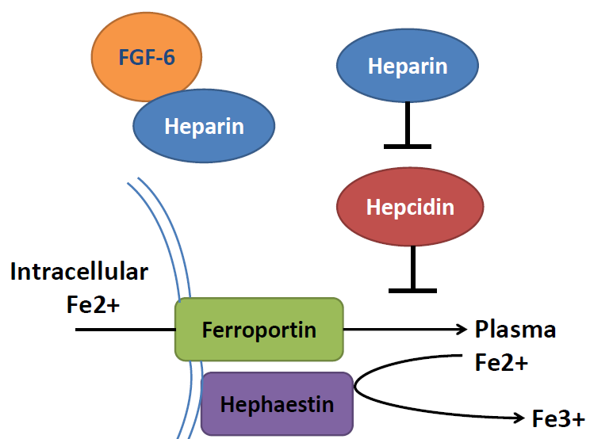
Ferrous form
Ferric form

Slide 23
P
STAT3
FGF-6
FGFR2
Heparin
Heparin
FGF-6
FGFR2
Hepcidin
Hepcidin
Ferrous form
Ferric form
P
FGF-6
R188Q
STAT3
D174V
FGF-6
E172X
FGFR2
Heparin
Heparin
Heparin
FGF-6
FGFR2
Hepcidin
Hepcidin
Ferrous form
Ferric form

Slide 24





Acknowledgements
Dr. Shicheng Guo
Marshfield Clinic
Prof. Jiucun Wang
Fudan University
Dr. Naren Epperla
OSU
Assoc Prof. Judy Smith
UW-Madison
Dr. Zhan Ye

Slide 25
Statistical Genetics Vignettes

Slide 26
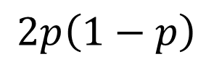
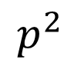
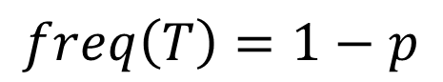
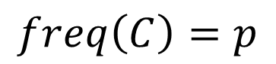
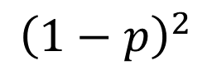
Vignette: Monogenic Recessive Disease Prevalence Estimation
ATGGGCATACGCCTTT
ATGGGCATACGCCTTT
ATGGGCATACGCCTTT
$$p^{2}$$
ATGGGCATACGCCTTT
ATGGGCATACGCCTTT
ATGGGCATACGCCTTT
ATGGGCATACGCCTTT
ATGGGCATACGCCTTT
ATGGGCATATGCCTTT
ATGGGCATACGCCTTT
ATGGGCATACGCCTTT
$$2p\left(1−p\right)$$
ATGGGCATATGCCTTT
ATGGGCATACGCCTTT
ATGGGCATACGCCTTT
ATGGGCATATGCCTTT
ATGGGCATACGCCTTT
ATGGGCATATGCCTTT
ATGGGCATACGCCTTT
ATGGGCATACGCCTTT
ATGGGCATATGCCTTT
$${\left(1−p\right)}^{2}$$
ATGGGCATACGCCTTT
ATGGGCATATGCCTTT
ATGGGCATACGCCTTT
$$freq\left(C\right)=p$$
$$freq\left(T\right)=1−p$$

Slide 27
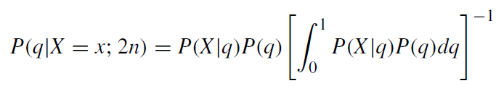
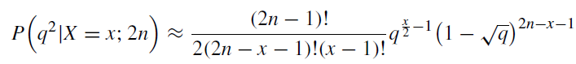
Recessive Disease Prevalence Estimation
From a sample of 2n sequences from the general
population, we want to estimate the frequency
of individuals with a recessive disease (q²)
x individuals from the sample of 2n, harbor a disease-causing allele

Slide 28
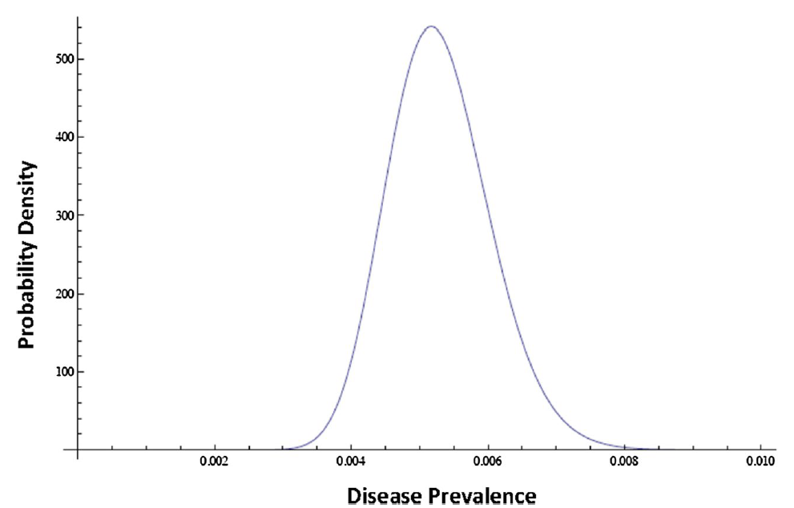
Oculocutaneous
albinism type 1A

Slide 29
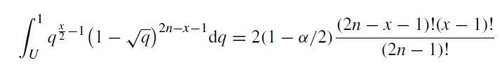
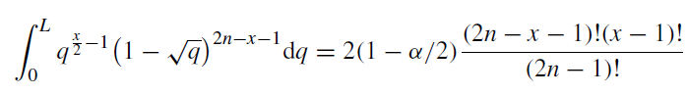
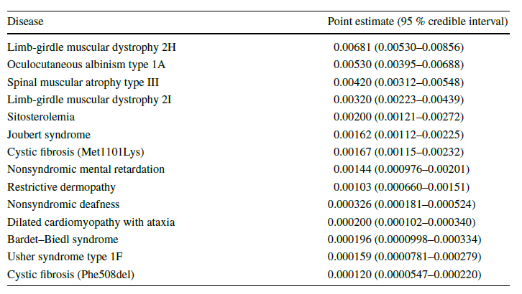

Slide 30
Vignette: Multiplicity Correction
In high throughput settings, distinguishing between signals generated under the null and alternative models can be convoluted.
Exp1
Exp2
Exp3
Exp4
Exp5
1.60E-07 | 2.83E-07 | 6.51E-08 | 8.62E-08 | 4.11E-08
3.02E-07 | 3.76E-07 | 3.42E-07 | 1.47E-07 | 1.03E-07
5.17E-07 | 3.84E-07 | 3.90E-07 | 3.01E-07 | 1.51E-07
6.05E-07 | 4.00E-07 | 3.97E-07 | 6.86E-07 | 2.02E-07
6.12E-07 | 4.59E-07 | 4.25E-07 | 7.30E-07 | 5.32E-07
7.70E-07 | 5.80E-07 | 5.41E-07 | 7.34E-07 | 6.51E-07

Slide 31
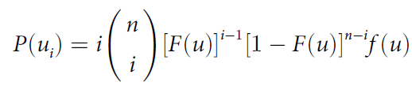
Vignette: Multiplicity Correction
Exp1
Exp2
Exp3
Exp4
Exp5
1.60E-07 | 2.83E-07 | 6.51E-08 | 8.62E-08 | 4.11E-08
Given n tests, what is the distribution of
top-ranked p-values under the null?
Using order statistics, we can derive the density of an arbitrarily-ranked
(i^{th} rank) random variable having distribution function F:

Slide 32
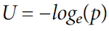
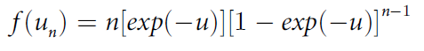
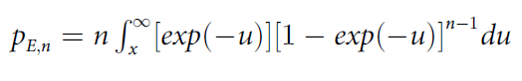
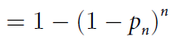
Vignette: Multiplicity Correction
Using the transform:
Under uniformly-distributed p-values, the pdf of the top-ranked
P-value is:
Hence, the p-value testing the significance of the of the top-ranked finding is:
Dunn-Sidak Correction
However, null p-values are never i.i.d. uniformly-distributed random variables
due to statistical artifacts, population stratification, etc.

Slide 33
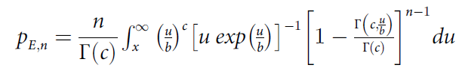
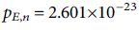
Vignette: Multiplicity Correction
Solution: Generalize the null density of
Treat as Gamma-distributed
Therefore, for an observed top-ranked –log p-value of ,
Using data from a large study on extreme BMI,

Slide 34
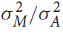
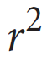
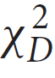

Vignette: A fine mapping theorem
Consider a 2-locus model, one biallelic site is causal with respect to a binary disease outcome, and the other biallelic site is in linkage disequilibrium with the causal site
Luo et al., 1997 showed for quantitative traits, the proportion
of additive variance of a trait due to a marker in linkage
disequilibrium with a causal QTL ( ) is simply
A1/A2
B1/B2

Slide 35



Fine mapping theorem
Maadooliat et al., 2016
Assist Prof. Mehdi Maadooliat
Marquette University

Slide 36


Enables Inference of OR at
Causal Sites using Data from
LD Markers

Slide 37


Fine mapping theorem application

Slide 38
Identity-by-Descent Mapping

Slide 39
Identity-by-Descent
Assist Prof. Mehdi Maadooliat
Marquette
University

Slide 40
Shared Chromosomal Regions Simplified Analytic Model
Simplistic Model
Disease mutation
Increasing number of meioses
Current affected individuals

Slide 41


Pretty Plots
5 Meioses Since Founder Assumed
2 patients
8 cM avg
10 patients
Φ(s)
recomb
Shared Region (cM)
50 patients
95% Interval (0.97 cM, 22.3 cM)

Slide 42
Monte Carlo Simulations
Can introduce disease predisposing alleles under arbitrary disease models and investigate
patterns of sharing, power, statistical tests, etc.
Coalescent
Founders
Mendel

Slide 43

Identity-by-Descent Mapping in Rheumatoid Arthritis
Systemic autoimmune disease
Synovium is primary immunological target
Disease prevalence ~ 1%
2-3x more frequent in females
MZ twin concordance 12-15%
DZ twin concordance 5%
λ_{s} ~ 5-10
Anti-CCP Abs, HLA is major locus
Possible infectious agent trigger
Severe joint damage from RA

Slide 44
Identity-by-Descent Mapping in Rheumatoid Arthritis
Extracted two different sets of RA patients based on ICD9 codes, anti-CCP/RF Ab test results, and anti-inflam drug prescriptions (n=388)
Extracted three non-overlapping sets of RA controls to conduct quasi-replication
Used the exome SNP data (500,000 variants, excellent coverage of exons, IBD SNPs, AIMs, and all GWAS-sig SNPs)
Phased the data using Beagle, blinded to case/control status
Conducted a global pairwise analysis obtaining IBD regions across the genome
Compared sharing within RA cases to sharing within control groups

Slide 45

Identity-by-Decent Mapping in RA
High performance computing cluster
Visualization tool: Shiny App

Slide 46

Chr 3 Signal
FSLT1 is a nice RA candidate gene
Expression in synovial fluid, monocytes, lymph nodes, peripheral blood
Interaction with CD14/TLR4 complex in myeloid-derived cells
Anti-Fstl1 Abs in RA synovial fluid and serum (Tanaka et al., 1998)
Upregulation of Fstl1 in collagen-induced arthritis mouse (Mitamae et al., 2006)

Slide 47
Acknowledgements
Shicheng Guo, PhD; Marshfield Clinic
Mehdi Maadooliat, PhD; Marquette University
Zhan Ye, PhD; Marshfield Clinic → Pfizer
Judy Smith, MD PhD; UW-Madison
Bob Steiner, MD; Marshfield Clinic, UW-Madison
Ray White, PhD; UCSF
Jiucun Wang, PhD; Fudan University
Shuai Jiang, PhD; Fudan University
Minghua Wang, PhD; Soochow University
Dongyi He, MD; Guanghua Hospital
Naren Epperla, MD; Ohio State University
Terrie Kitchner; Marshfield Clinic

Slide 48

Percentage high positive stain cells

